Slide 1
Blockchain

Slide 2
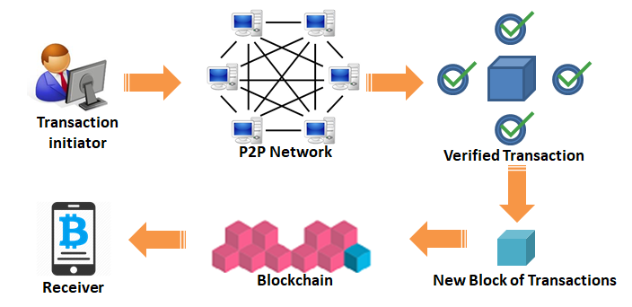
A blockchain is a distributed database that is practically immutable, maintained by decentralized peer to peer network using consensus mechanism, cryptography and back referencing blocks to order and validate the transactions

Slide 3
Blockchain vs. Distributed DB
Blockchains maintain a log (aka a ledger) of all transactions since the start of deployment
e.g. in Bitcoin, there is no direct record of the current state
The trust model is fundamentally different
1. INTRODUCTION
ZHANG, VITENBERG, JACOBSEN © 2018
9

Slide 4
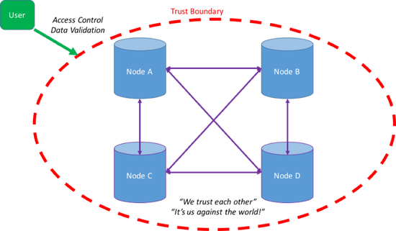
Blockchain vs. Distributed DB
Blockchains maintain a log (aka a ledger) of all transactions since the start of deployment
e.g. in Bitcoin, there is no direct record of the current state
The trust model is fundamentally different
Distributed
database
1. INTRODUCTION
ZHANG, VITENBERG, JACOBSEN © 2018
9

Slide 5
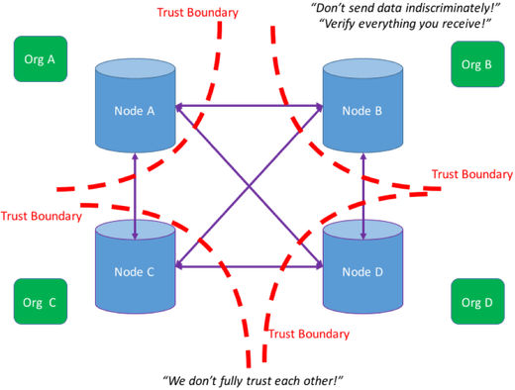
Blockchain vs. Distributed DB
Blockchains maintain a log (aka a ledger) of all transactions since the start of deployment
e.g. in Bitcoin, there is no direct record of the current state
The trust model is fundamentally different
Blockchain /
distributed ledger
1. INTRODUCTION
ZHANG, VITENBERG, JACOBSEN © 2018
9

Slide 6



Main benefits of DLTs
Enable parties who do not fully trust each other to form and maintain consensus about the existence, status and evolution of a set of shared facts
The ecosystem of smart contracts
2.1 CONCEPTS
ZHANG, VITENBERG, JACOBSEN © 2018

Slide 7





Immutability using Hashing
Blockchain data structure maintained at every peer
Block 0 Block 1 Block 2
Client 1
Client2
P1
Block hash:
000000958fdji
Block hash:
000000948fixf
Block hash:
00000090b41bx
Previous block:
Previous block: 000000958fdji
Previous block: 000000948fixf
P2
P3
-
Transaction 4325afde
Transaction 1025asde
Transaction 0495fjdi
Transaction 97875ihge
Transaction
8875iire
Transaction
1236foer
P4
Transaction 4546ofre
Transaction 4236owqe
Transaction 4364rote
2.1 CONCEPTS
ZHANG, VITENBERG, JACOBSEN © 2018
16

Slide 8

Immutability using Hashing
Blockchain data structure maintained at every peer
Block 0 Block 1 Block 2
Client 1
Client2
P1
Block hash:
000000958fdji
Block hash:
000000948fixf
Block hash:
00000090b41bx
Previous block:
Previous block: 000000958fdji
Previous block: 000000948fixf
P2
P3
-
Transaction 4325afde
Transaction 1025asde
Transaction 0495fjdi
Transaction 97875ihge
Transaction
8875iire
Transaction
1236foer
P4
Transaction 4546ofre
Transaction 4236owqe
Transaction 4364rote
2.1 CONCEPTS
ZHANG, VITENBERG, JACOBSEN © 2018
16

Slide 9
Immutability using Hashing
Blockchain data structure maintained at every peer
Block 0 Block 1 Block 2 Block 3
Client 1
Client2
P1
Block hash:
000000958fdji
Block hash:
000000948fixf
Block hash:
00000090b41bx
Block hash:
???
Previous block:
Previous block: 000000958fdji
Previous block: 000000948fixf
Previous block: 00000090b41bx
P2
P3
-
Transaction 4325afde
Transaction 1025asde
Transaction 0495fjdi
???
Transaction 97875ihge
Transaction
8875iire
Transaction
1236foer
P4
Transaction 4546ofre
Transaction 4236owqe
Transaction 4364rote
Requires a Byzantine
consensus algorithm!
2.1 CONCEPTS
ZHANG, VITENBERG, JACOBSEN © 2018
16

Slide 10
Bitcoin Transactions
Transaction C (by Alice) in 1
 | out 1 ฿2 -> Bob
 | out 2 ฿0.9 -> Carol
in 2 |  | out 3 ฿0.1 -> _
Transaction A
in
out 1
out 2
฿1 -> Alice
Transaction B
in 1
out 1
฿2 -> Alice
2.3 BITCOIN TRANSACTIONS
ZHANG, VITENBERG, JACOBSEN © 2018
27

Slide 11
Bitcoin Transactions
Each user possesses a wallet identified by public/private key pairs
Transaction C (by Alice) in 1
 | out 1 ฿2 -> Bob
 | out 2 ฿0.9 -> Carol
in 2 |  | out 3 ฿0.1 -> _
Transaction A
in
out 1
out 2
฿1 -> Alice
Transaction B
in 1
out 1
฿2 -> Alice
2.3 BITCOIN TRANSACTIONS
ZHANG, VITENBERG, JACOBSEN © 2018
27

Slide 12
Bitcoin Transactions
Each user possesses a wallet identified by public/private key pairs
User encrypts a new transaction C using the private key
Transaction A
Transaction C (by Alice)
in
out 1
out 2
฿1 -> Alice
in 1
out 1
฿2 -> Bob
Transaction B
in 1
out 2
฿0.9 -> Carol
out 1
฿2 -> Alice
in 2
out 3
฿0.1 -> _
2.3 BITCOIN TRANSACTIONS
ZHANG, VITENBERG, JACOBSEN © 2018
27

Slide 13
Bitcoin Transactions
Each user possesses a wallet identified by public/private key pairs
User encrypts a new transaction C using the private key
Transaction A
Transaction C (by Alice)
in
out 1
C contains outputs to wallet addresses
out 2
฿1 -> Alice
in 1
out 1
฿2 -> Bob
Transaction B
in 1
out 2
฿0.9 -> Carol
out 1
฿2 -> Alice
in 2
out 3
฿0.1 -> _
2.3 BITCOIN TRANSACTIONS
ZHANG, VITENBERG, JACOBSEN © 2018
27

Slide 14
Bitcoin Transactions
Each user possesses a wallet identified by public/private key pairs
User encrypts a new transaction C using the private key
Transaction A
Transaction C (by Alice)
in
out 1
C contains outputs to wallet addresses
out 2
฿1 -> Alice
in 1
out 1
฿2 -> Bob
Transaction B
in 1
out 2
฿0.9 -> Carol
The transaction fee is given as reward (explained later)
out 1
฿2 -> Alice
in 2
out 3
฿0.1 -> _
2.3 BITCOIN TRANSACTIONS
ZHANG, VITENBERG, JACOBSEN © 2018
27

Slide 15
Bitcoin Transactions
Each user possesses a wallet identified by public/private key pairs
User encrypts a new transaction C using the private key
Transaction A
Transaction C (by Alice)
in
out 1
C contains outputs to wallet addresses
out 2
฿1 -> Alice
in 1
out 1
฿2 -> Bob
Transaction B
Tx C must reference unspent transactions outputs (UTXOs) from previous blocks equal to the total output of tx C (3 BTC)
in 1
out 2
฿0.9 -> Carol
The transaction fee is given as reward (explained later)
out 1
฿2 -> Alice
in 2
out 3
฿0.1 -> _
2.3 BITCOIN TRANSACTIONS
ZHANG, VITENBERG, JACOBSEN © 2018
27

Slide 16
Bitcoin Transactions
Each user possesses a wallet identified by public/private key pairs
User encrypts a new transaction C using the private key
Transaction A
Transaction C (by Alice)
in
out 1
C contains outputs to wallet addresses
out 2
฿1 -> Alice
in 1
out 1
฿2 -> Bob
Transaction B
Tx C must reference unspent transactions outputs (UTXOs) from previous blocks equal to the total output of tx C (3 BTC)
in 1
out 2
฿0.9 -> Carol
The transaction fee is given as reward (explained later)
out 1
฿2 -> Alice
in 2
out 3
฿0.1 -> _
Once spent, a TXO cannot be used again: miners verify every transaction
2.3 BITCOIN TRANSACTIONS
ZHANG, VITENBERG, JACOBSEN © 2018
27

Slide 17
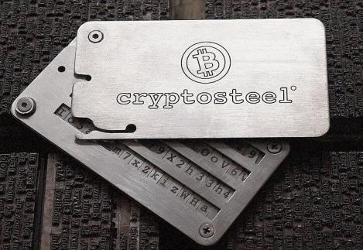
Wallets and addresses
Users require a wallet to store money
This includes any user, including but not limited to miners
Wallet is authenticated and identified by a public/private key pair
Generated using ECDSA (Elliptic curve cryptography)
More details here: https://en.bitcoin.it/wiki/Technical_background_of_version_1_Bitcoin_addresses
Redeeming transactions:
Each TXO address is a hash of the public key of the receiver, who signs proof with the private key
Transactions do not have a “from” address, so it is impossible to prove you are the
sender
Each address is designed to be single use: wallet programs will automatically generate new addresses
Losing your private key:
Loss of private key means the wallet and its funds are permanently locked, as it is no longer possible to sign proofs redeeming existing TXOs.
This money is essentially lost, thereby reducing the total amount of currency in Bitcoin
Trusting an online service to store your key is also risky, since there is no way to prove that you are the rightful owner if the key is stolen or misused
The most reliable solution is to store your private keys on tamper-proof hardware wallets
2.3 BITCOIN TRANSACTIONS
28

Slide 18
Communication in Bitcoin
Broadcast to all the network Two primary uses
Users broadcast their transactions
Miners broadcasts updates to the blockchain (new blocks)
Implemented via gossiping protocol in a P2P network
Not terribly efficient but has not been a bottleneck so far
Works because financial transactions are very short and their rate in Bitcoin is far below that of credit cards
Needs to be fairly reliable for the system to work but 100 percent reliability in message delivery is not required
Users and miners need to detect message loss and retransmit messages if needed
Message propagation should be reasonably fast
Slower network quantifiably increases the risk of attacks
2.4 BITCOIN NETWORK

Slide 19


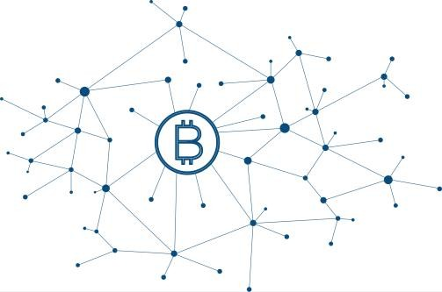
Transaction Flow
Bob generates and send a public key address.
Alice creates a transaction using this address.
Alice sends the new transaction to the network.
The transaction is broadcast using gossiping.
The transaction is included in a block.
Bob can verify the transaction is in the blockchain.
Bob can now sign new transactions which redeem this address.
Alice (Sender)
Bob (Receiver)
Transaction A
Transaction B
in 1
in 1 Bob.Address1
out 1
฿1 ->
Bob.Address1
out 1
2.4 BITCOIN NETWORK

Slide 20


Consensus in Bitcoin
The network needs to agree on
Which recently broadcast transactions go into the blockchain
In what order
The general anatomy of consensus:
Make a proposal
Reach a consensus
Announce the decision
2.5 BITCOIN CONSENSUS
31

Slide 21
Consensus in Bitcoin
The network needs to agree on
Which recently broadcast transactions go into the blockchain
In what order
The general anatomy of consensus:
Make a proposal
Tough problem
Especially in P2P
Dozens of impossibility
results since 1983
Does not scale beyond
Reach a consensus
~30 participants
Takes long time to
converge
Announce the decision
2.5 BITCOIN CONSENSUS
31

Slide 22
Challenge 1: who proposes and when?
The network cannot sustain each and every user or peer
making a proposal whenever she wishes
Made worse by the proliferation of identities (Sybil attack)
Need to moderate the number of proposers and rate of concurrent proposals
While keeping them sufficiently high
Several principal solutions
Proof-of-work: need to do heavy computation and show the proof of it
Proof-of-stake: need to possess a sufficient amount of coins
Important optimization: propose new transactions in batches
A block in Bitcoin is structured as a tree of proposed transactions
With nice cryptographic properties; called a Merkle tree
2.5 BITCOIN CONSENSUS
32

Slide 23










Cryptopuzzles in Bitcoin
The proposer has to find nonce, such that hash(nonce | H | Tr₁ | … | Tr_{n}) < target
Effectively has to scan the entire nonce space
target is a fraction of the hash space
Every node recomputes target every 2016 blocks
Such that the average time for the whole network to solve a cryptopuzzle is 10 min
A block in
Bitcoin
nonce
H=hash pointer for prev block
Tr₁
For proposer p,
10 𝑚𝑖𝑛𝑢𝑡𝑒𝑠
𝑚𝑒𝑎𝑛 𝑡𝑖𝑚𝑒 𝑡𝑜 𝑛𝑒𝑥𝑡 𝑏𝑙𝑜𝑐𝑘 =
𝑓𝑟𝑎𝑐𝑡𝑖𝑜𝑛 𝑜𝑓 𝑝′𝑠 𝑐𝑜𝑚𝑝𝑢𝑡𝑖𝑛𝑔 𝑝𝑜𝑤𝑒𝑟
Tr₂
⋮
Tr_{n}
The solution is fast to verify
ZHANG, VITENBERG, JACOBSEN © 2018
33

Slide 24







Proof-of-Work Mining in Bitcoin
Pending Transactions Pool
Hash(block,nonce) <
0000000XXXXX…
Block 3
2 Hash Tx D Tx N Tx C nonce
Transaction C
Transaction D
…
Transaction N
Block 0
Block 1
Block 2
Proof-of-Work:
000000958fdji
Proof-of-Work:
000000948fixf
Proof-of-Work: 00000090b41bx
Previous block:
Previous POW: 000000958fdji
Transaction
1025asde
Previous POW: 000000948fixf
Transaction 0495fjdi
-
Transaction 4325afde
Transaction 97875ihge
Transaction 8875iire
Transaction 1236foer
Transaction 4546ofre
nonce 04934938
Transaction 4236owqe
Transaction 4364rote
nonce 87465523
nonce 87874951
2.5 BITCOIN CONSENSUS
ZHANG, VITENBERG, JACOBSEN © 2018
34

Slide 25
Proof-of-Work Mining in Bitcoin
Pending
Pending Transactions Pool
transactions are propagated to the peers (miners)
Hash(block,nonce) <
0000000XXXXX…
Block 3
2 Hash Tx D Tx N Tx C nonce
Transaction C
Transaction D
…
Transaction N
Block 0
Block 1
Block 2
Proof-of-Work:
000000958fdji
Proof-of-Work:
000000948fixf
Proof-of-Work: 00000090b41bx
Previous block:
Previous POW: 000000958fdji
Transaction
1025asde
Previous POW: 000000948fixf
Transaction 0495fjdi
-
Transaction 4325afde
Transaction 97875ihge
Transaction 8875iire
Transaction 1236foer
Transaction 4546ofre
nonce 04934938
Transaction 4236owqe
Transaction 4364rote
nonce 87465523
nonce 87874951
2.5 BITCOIN CONSENSUS
ZHANG, VITENBERG, JACOBSEN © 2018
34

Slide 26
Proof-of-Work Mining in Bitcoin
Pending
Pending Transactions Pool
transactions are propagated to the peers (miners)
Hash(block,nonce) <
0000000XXXXX…
Block 3
2 Hash Tx D Tx N Tx C nonce
Transaction C
Transaction D
…
A miner verifies and
Transaction N puts transactions in a
block, finds nonce
Block 0
Block 1
Block 2
Proof-of-Work:
000000958fdji
Proof-of-Work:
000000948fixf
Proof-of-Work: 00000090b41bx
Previous block:
Previous POW: 000000958fdji
Transaction
1025asde
Previous POW: 000000948fixf
Transaction 0495fjdi
-
Transaction 4325afde
Transaction 97875ihge
Transaction 8875iire
Transaction 1236foer
Transaction 4546ofre
nonce 04934938
Transaction 4236owqe
Transaction 4364rote
nonce 87465523
nonce 87874951
2.5 BITCOIN CONSENSUS
ZHANG, VITENBERG, JACOBSEN © 2018
34

Slide 27
Proof-of-Work Mining in Bitcoin
Pending
Pending Transactions Pool
transactions are propagated to the peers (miners)
Hash(block,nonce) <
0000000XXXXX…
Block 3
2 Hash Tx D Tx N Tx C nonce
Transaction C
Transaction D
…
Number of leading zeroes (difficulty) depend on the global hash-rate, s.t. one block is solved per 10 minutes
A miner verifies and
Transaction N puts transactions in a
block, finds nonce
Block 0
Block 1
Block 2
Proof-of-Work:
000000958fdji
Proof-of-Work:
000000948fixf
Proof-of-Work: 00000090b41bx
Previous block:
Previous POW: 000000958fdji
Transaction
1025asde
Previous POW: 000000948fixf
Transaction 0495fjdi
-
Transaction 4325afde
Transaction 97875ihge
Transaction 8875iire
Transaction 1236foer
Transaction 4546ofre
nonce
Transaction 4236owqe
Transaction 4364rote
nonce
nonce
04934938
87465523
87874951
2.5 BITCOIN CONSENSUS
34

Slide 28
Proof-of-Work Mining in Bitcoin
Pending
Pending Transactions Pool
transactions are propagated to the peers (miners)
Hash(block,nonce) <
0000000XXXXX…
Block 3
2 Hash Tx D Tx N Tx C nonce
Transaction C
Transaction D
…
Number of leading zeroes (difficulty) depend on the global hash-rate, s.t. one block is solved per 10 minutes
A miner verifies and
Transaction N puts transactions in a
block, finds nonce
The miner attaches the solved block to the chain, or stops solving if someone else finds a valid block.
Block 0
Block 1
Block 2
Block 3
Proof-of-Work:
000000958fdji
Proof-of-Work:
000000948fixf
Proof-of-Work: 00000090b41bx
Proof-of-Work:
000000r9d8fjj
Previous block:
Previous POW: 000000958fdji
Transaction
1025asde
Previous POW: 000000948fixf
Transaction 0495fjdi
Previous block: 00000090b41bx
-
Transaction 4325afde
Transaction D
Transaction 97875ihge
Transaction 8875iire
Transaction 1236foer
Transaction N
Transaction 4546ofre
nonce
Transaction 4236owqe
Transaction 4364rote
Transaction C
nonce
nonce
nonce
04934938
87465523
87874951
79146512
2.5 BITCOIN CONSENSUS
34

Slide 29
Challenge 2: Why propose non-empty blocks?
Two incentive mechanisms in Bitcoin
Block creation reward: a block proposal creates a number of new bitcoins and transfers them to the proposer
Included as a separate transaction in the block
Ensures that each proposer solves a different cryptopuzzle
The only way to create new bitcoins
The amount is predefined and gets halved every 210,000 blocks
Predicted to go down to zero before year 2140
The geometric progression totals to 21 million bitcoins
The rules may change in the future
Transaction inclusion fee: Alice can decide to pay a small fee to the block creator as part of her transaction
Voluntarily, there is no predefined amount
2.5 BITCOIN CONSENSUS

Slide 30
Cryptoeconomy of Mining
Incentives give rise to the mining industry in Bitcoin
Miners: cracking cryptopuzzles and listening to transaction broadcasts
Expenses: mining rig + operating costs (electricity, cooling, repairs)
Paid in real currency
Operating costs are variable
Profits: block reward + transaction fee * # of transactions in a block
Paid in Bitcoins
The fee and rate of transactions are unpredictable
The mean time to next block is easy to compute
However, the per-miner sample is small while variations are huge
Mining pools: groups of cooperating miners
2.5 BITCOIN CONSENSUS

Slide 31
Reaching consensus in Bitcoin
A miner broadcasts the proposed block
The block includes a hash to the latest block known to the miner
2.5 BITCOIN CONSENSUS
37

Slide 32
Reaching consensus in Bitcoin
A miner broadcasts the proposed block
The block includes a hash to the latest block known to the miner
When a peer receives a proposed block
Check that the proof of cryptopuzzle solution is valid
Check that each transaction is valid (business logic)
If the hash pointer is valid, append the new block to the local copy of the blockchain
2.5 BITCOIN CONSENSUS
37

Slide 33
Reaching consensus in Bitcoin
A miner broadcasts the proposed block
The block includes a hash to the latest block known to the miner
When a peer receives a proposed block
Check that the proof of cryptopuzzle solution is valid
Check that each transaction is valid (business logic)
If the hash pointer is valid, append the new block to the local copy of the blockchain
Local copies may diverge!
Lost messages and concurrent blocks arriving in reverse order
The probability depends on the network
2.5 BITCOIN CONSENSUS
37

Slide 34
Reaching consensus in Bitcoin
A miner broadcasts the proposed block
The block includes a hash to the latest block known to the miner
When a peer receives a proposed block
Check that the proof of cryptopuzzle solution is valid
Check that each transaction is valid (business logic)
If the hash pointer is valid, append the new block to the local copy of the blockchain
Conflict resolution: if the proposed chain is longer than the current local copy, replace
the local copy
Local copies may diverge!
Lost messages and concurrent blocks arriving in reverse order
The probability depends on the network
2.5 BITCOIN CONSENSUS
37

Slide 35
Reaching consensus in Bitcoin
A miner broadcasts the proposed block
The block includes a hash to the latest block known to the miner
When a peer receives a proposed block
Check that the proof of cryptopuzzle solution is valid
Check that each transaction is valid (business logic)
If the hash pointer is valid, append the new block to the local copy of the blockchain
Conflict resolution: if the proposed chain is longer than the current local copy, replace
the local copy
Local copies may diverge!
Lost messages and concurrent blocks arriving in reverse order
The probability depends on the network
Probabilistic convergence over time is proven when using the longest chain for
conflict resolution
The probability of a block being non-final decreases exponentially with the number of later blocks stored in the chain
The standard client sends a confirmation after six later blocks stored in the chain
Takes an order of one hour in practice
2.5 BITCOIN CONSENSUS
37

Slide 36











Branching
Branch 1
Block 3
Common Blockchain
Proof-of-Work: 0000009ff33xe
Block 0
Block 1
Block 2
Previous POW:
00000090b41bx
Proof-of-Work: 000000958fdji
Proof-of-Work: 000000948fixf
Proof-of-Work: 00000090b41bx
Transactions
…
Previous block:
Previous POW: 000000958fdji
Previous POW: 000000948fixf
nonce
-
Transactions
…
Transactions
…
Transactions
…
Branch 2
nonce
nonce
nonce
Block 3
Proof-of-Work:
000000hhjg93g
Previous POW: 00000090b41bx
Transactions
…
nonce
2.5 BITCOIN CONSENSUS
38

Slide 37
Branching
Here, two blocks 3 are
Branch 1
solved at the same time
by different miners (very
Block 3
Common Blockchain
Proof-of-Work: 0000009ff33xe
rare occurrence)
Block 0
Block 1 Block 2
Previous POW:
00000090b41bx
Proof-of-Work: 000000958fdji
Proof-of-Work: 000000948fixf
Proof-of-Work: 00000090b41bx
Transactions
…
Previous block:
Previous POW: 000000958fdji
Previous POW: 000000948fixf
nonce
-
Transactions
…
Transactions
…
Transactions
…
Branch 2
nonce
nonce
nonce
Block 3
Proof-of-Work:
000000hhjg93g
Previous POW: 00000090b41bx
Transactions
…
nonce
2.5 BITCOIN CONSENSUS
38

Slide 38
Branching
Here, two blocks 3 are
Branch 1
solved at the same time
by different miners (very
Block 3
Common Blockchain
Proof-of-Work: 0000009ff33xe
rare occurrence)
Block 0
Block 1 Block 2
Previous POW:
00000090b41bx
Proof-of-Work: 000000958fdji
Proof-of-Work: 000000948fixf
Proof-of-Work: 00000090b41bx
Transactions
…
Previous block:
Previous POW: 000000958fdji
Previous POW: 000000948fixf
nonce
-
Transactions
…
Transactions
…
Transactions
…
Branch 2
nonce
nonce nonce
Due to network delays, different miners begin working on their version of block 3
Block 3
Proof-of-Work:
000000hhjg93g
Previous POW: 00000090b41bx
Transactions
…
nonce
2.5 BITCOIN CONSENSUS
38

Slide 39



Branching
Here, two blocks 3 are
Branch 1
Block 4
solved at the same time
by different miners (very
Block 3
Common Blockchain
Proof-of-Work: 0000009ff33xe
Proof-of-Work: 000000zzzbbf4
rare occurrence)
Block 0
Block 1 Block 2
Previous POW:
00000090b41bx
Previous POW:
0000009ff33xe
Proof-of-Work: 000000958fdji
Proof-of-Work: 000000948fixf
Proof-of-Work: 00000090b41bx
Transactions
…
Transactions
…
Previous block:
Previous POW: 000000958fdji
Previous POW: 000000948fixf
nonce
nonce
-
Transactions
…
Transactions
…
Transactions
…
Branch 2
Block 4
nonce
nonce nonce
Due to network delays, different miners begin working on their version of block 3
Block 3
Proof-of-Work:
000000hhjg93g
Proof-of-Work:
???
Previous POW: 00000090b41bx
Previous POW: 000000hhjg93g
Transactions
…
Transactions
…
nonce
nonce
2.5 BITCOIN CONSENSUS
38

Slide 40
Branching
Due to variance, one branch will find a block
faster than the other Branch 1
Block 4
Here, two blocks 3 are
solved at the same time
by different miners (very
Block 3
Common Blockchain
Proof-of-Work: 0000009ff33xe
Proof-of-Work: 000000zzzbbf4
rare occurrence)
Block 0
Block 1 Block 2
Previous POW:
00000090b41bx
Previous POW:
0000009ff33xe
Proof-of-Work: 000000958fdji
Proof-of-Work: 000000948fixf
Proof-of-Work: 00000090b41bx
Transactions
…
Transactions
…
Previous block:
Previous POW: 000000958fdji
Previous POW: 000000948fixf
nonce
nonce
-
Transactions
…
Transactions
…
Transactions
…
Branch 2
Block 4
nonce
nonce nonce
Due to network delays, different miners begin working on their version of block 3
Block 3
Proof-of-Work:
000000hhjg93g
Proof-of-Work:
???
Previous POW: 00000090b41bx
Previous POW: 000000hhjg93g
Transactions
…
Transactions
…
nonce
nonce
2.5 BITCOIN CONSENSUS
38

Slide 41

Branching
Due to variance, one branch will find a block
faster than the other Branch 1
Block 4
Here, two blocks 3 are
solved at the same time
by different miners (very
Block 3
Common Blockchain
Proof-of-Work: 0000009ff33xe
Proof-of-Work: 000000zzzbbf4
rare occurrence)
Block 0
Block 1 Block 2
Previous POW: Previous POW:
_{When m}0_{i}0_{n}00_{e}00_{r}9_{s}0b4_{r}1_{e}bx_{ceive a}0000009ff33xe
Proof-of-Work: 000000958fdji
Proof-of-Work: 000000948fixf
Proof-of-Work:
valid block from a longer
Transactions
00000090b41bx
Transactions
…
…
Previous block:
Previous POW: 000000958fdji
Previous bPOrWa: nch, they_{non}t_{ce}hrow away nonce
-
000000948fixf
their own branch (txs are reverted)
Transactions
…
Transactions
…
Transactions
…
B ch 2
Block 4
ran
nonce
nonce nonce
Due to network delays, different miners begin working on their version of block 3
Block 3
Proof-of-Work:
000000hhjg93g
Proof-of-Work:
???
Previous POW: 00000090b41bx
Previous POW: 000000hhjg93g
Transactions
…
Transactions
…
nonce
nonce
2.5 BITCOIN CONSENSUS
38

Slide 42
Branching
Due to variance, one branch will find a block
faster than the other Branch 1
Here, two blocks 3 are
solved at the same time
by different miners (very
Block 3
Block 4 Block 5
Common Blockchain
Proof-of-Work: 0000009ff33xe
Proof-of-Work: 000000zzzbbf4
Proof-of-Work: 000000f32367x
rare occurrence)
Block 0
Block 1 Block 2
Previous POW: Previous POW:
Previous POW:
000000zzzbbf4
_{When m}0_{i}0_{n}00_{e}00_{r}9_{s}0b4_{r}1_{e}bx_{ceive a}0000009ff33xe
Proof-of-Work: 000000958fdji
Proof-of-Work: 000000948fixf
Proof-of-Work:
valid block from a longer
Transactions
Transactions
…
00000090b41bx
Transactions
…
…
Previous block:
Previous POW: 000000958fdji
Previous bPOrWa: nch, they_{non}t_{ce}hrow away nonce
nonce
-
000000948fixf
their own branch (txs are reverted)
Transactions
…
Transactions
…
Transactions
…
B ch 2
Block 4
ran
nonce
nonce nonce
Due to network delays, different miners begin working on their version of block 3
Block 3
Proof-of-Work:
000000hhjg93g
Proof-of-Work:
???
Previous POW: 00000090b41bx
Previous POW: 000000hhjg93g
Transactions
…
Transactions
…
nonce
nonce
2.5 BITCOIN CONSENSUS
38

Slide 43
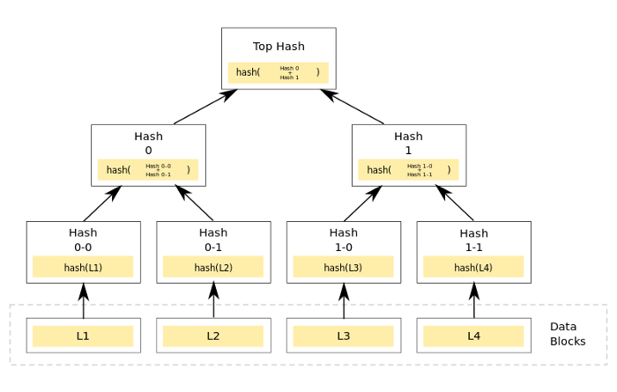
Merkle Tree

Slide 44
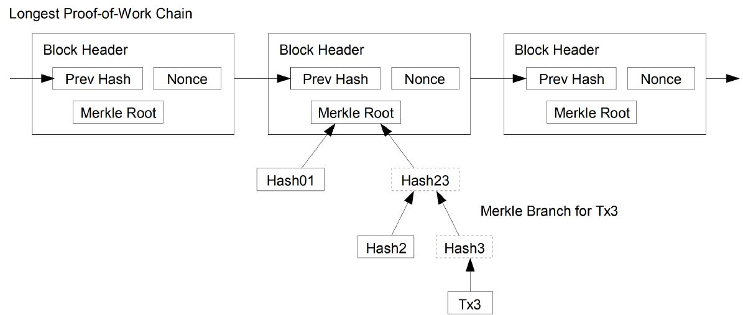
Merkle tree in the blockchain

Slide 45
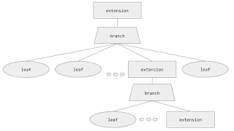
Merkle Practicia Tree
• empty nodes: blank nodes,
• leaf nodes: standard nodes with a key and a value,
• branch nodes: lists with a length of 17
• extension nodes: key-value nodes whose value is the hash of another node.

Slide 46
Merkle Practicia Tree
In the MPT, every node has a hash value. Each node’s hash is decided by the SHA3 hash value of its contents. This hash is also used as the key that refers to the node.
Go-ethereum uses levelDB, and parity uses rocksDB to store states. They are key-value storages.
Keys and values saved in the storage are not the key-values of the Ethereum state. The value that is stored in the storage is the content of MPT node while the key is the hash of this node.

Slide 47
MPT
Key-values of the Ethereum state are used as paths on the MPT. Nibble is the unit used to distinguish key values in the MPT, so each node can have up to 16 branches. Additionally, since a node has its own value, a branch node is an array of 17 items composed of 1 node value and 16 branches.

Slide 48

A Node that does not have a child node is called a leaf node.
A leaf node consists of two items: its path and value. For example, let’s say the key “0xBEA” contains 1000 and the key “0xBEE” contains 2000. Then, there should be a branch node with the “0xBE” path, and, under that node, two leaf nodes with two paths (“0xA” and “0xE”) will be attached.

Slide 49
Public Blockchain
This blockchain is a permissionless, non-restrictive, distributed ledger system, which means anyone who is connected to the internet can join a blockchain network and become a part of it.
The basic use of such blockchain is for exchanging cryptocurrencies and mining. Moreover, it maintains trust among the whole community of users as everyone in the network feels incentivized to work towards the improvement of the public network.
The first example of such a blockchain is Bitcoin that enabled everyone to perform transactions. Litcoin and Ethereum are also examples of a public blockchain.

Slide 50
Public Blockchains
Advantages of Public Blockchains
Complete trustable and transparent
No intermediaries
Secured
Disadvantages of Public Blockchains
Scalability
Lack of transaction speed
Consumes a lot of energy

Slide 51
Private Blockchain
Unlike the public, a private blockchain is a permissioned and a restrictive blockchain that operates in a closed network. Such blockchain is mostly used within an organization where only particular members are participants of a blockchain network. It is best suited for enterprises and businesses that want to use blockchain only for internal uses.
The major difference between the blockchains is that the public is highly accessible, whereas private is confined to a particular group of people. Moreover, a private blockchain is more centralized due to the fact because a single authority maintains the network. Corda, Hyperledger Fabric, Hyperledger Sawtooth, Corda are the examples of the private blockchain.

Slide 52
Advantages:
Higher transaction per second (TPS)
Highly scalable
Disadvantages:
Less secured compared to Public blockchains
Less decentralized
Achieving trust is difficult

Slide 53
Blockchain Forking
The decentralized nature of public blockchains (for example, Bitcoin and Ethereum) means that participants on the network must be able to come to an agreement as to the shared state of the blockchain(shared public ledger and blocks and the blockchain protocol).
Unanimous consensus amongst the network nodes results in a single blockchain that contains verified data(transactions) that the network asserts to be correct. However, many times, the nodes in the network can’t come in unanimous consensus regarding the future state of the blockchain. This event leads to forks meaning that point in which the ideal ‘single’ chain of blocks is split into two or more chains which are all valid.

Slide 54
Fork
This gives rise to three types of forks which can occur based on the backwards-compatibility of the blockchain protocol and the time instant at which a new block is mined. These types are as follows :
Soft Fork: when the blockchain protocol is altered in a backwards-compatible way
Hard Fork: when the blockchain protocol is altered in a non backwards-compatible way
Temporary Fork: when two miners mine a new block at the same time

Slide 55
Soft Fork
When there is a change in the software that runs on the nodes (better called as ‘full nodes’) to function as a network participant, the change is such that the new blocks mined on the basis of new rules (in the Blockchain protocol) are also considered valid by the old version of the software. This feature is also called as backwards-compatibility.
Example: The Bitcoin network’s SegWit update added a new class of addresses (Bech32). A full node with a P2SH type address could do a valid transaction with a node of Bech32 type address.

Slide 56
Hard Fork
When there is a change in the software that runs on the full nodes to function as a network participant, the change is such that the new blocks mined on the basis of new rules (in the Blockchain protocol) are not considered valid by the old version of the software. When hard forks occur, new currency come into existence (with valid original currency) like in the case of Ethereum (original : Ethereum, new : Ethereum Classic) and Bitcoin (original : Bitcoin, new : Bitcoin cash).
The final decision to join a particular chain rests with the full node. If chosen to join the new chain, the software has to be upgraded to make newer transactions valid while the nodes who do not choose to upgrade their software continue working the same.

